Slide 1


Thank you
Lecture 5: Financial Statement Analysis – Part 2
Cash Flow Analysis
Presentation to Cox Business Students
FINA 3320: Financial Management

Slide 2
Purpose of This Lecture
Develop final tool for analyzing financial statements using
  Cash Flow Analysis
    Become familiar with constructing financial managers or analysts cash flow summary
    Learn to interpret and analyze cash flow summary
Notes:
Understanding Media: Extensions of Man, published in 1964.
The medium you use to send a particular message automatically predisposes audience members to make certain tacit assumptions about the message before they even read it.
Put another way, people unconsciously judge books by their covers.
How does this apply to business communications?
If you want to announce cutbacks in your company’s health benefits, don’t deliver the message with a glitzy, over-the-top, no-expenses-spared campaign.
Conversely, if you want to position your company as a leader in innovation, don’t advertise your message on sandwich boards dangling from the necks of ragamuffins traipsing around in front of gas stations.

Slide 3
The Example: Cox Oil Company, Inc.
We will employ the Cox Oil Company, Inc. example throughout
Cox example will illustrate basic financial analysis techniques and procedures
  True test of understanding is ability to apply concepts
  Cox example provides application of each financial analysis
    Makes is easier to ‘reverse engineer’
Notes:
Understanding Media: Extensions of Man, published in 1964.
The medium you use to send a particular message automatically predisposes audience members to make certain tacit assumptions about the message before they even read it.
Put another way, people unconsciously judge books by their covers.
How does this apply to business communications?
If you want to announce cutbacks in your company’s health benefits, don’t deliver the message with a glitzy, over-the-top, no-expenses-spared campaign.
Conversely, if you want to position your company as a leader in innovation, don’t advertise your message on sandwich boards dangling from the necks of ragamuffins traipsing around in front of gas stations.

Slide 4
Cash Flow Analysis
We will undertake the following three items using the overhead projector (i.e., ‘old school’)…
  (1) Discuss the financial managers’ cash flow summary format
  (2) In-class step-by-step construction, review and discussion (analysis) of Cash Flow Example #1
  (3) Calculation and review of Cox Oil Company, Inc. cash flow summary
Notes:
So let’s look more closely at how this concept applies to internal communications.
When it comes to internal communications, there’s a virtually limitless supply of messages you might have to deliver.

Slide 5
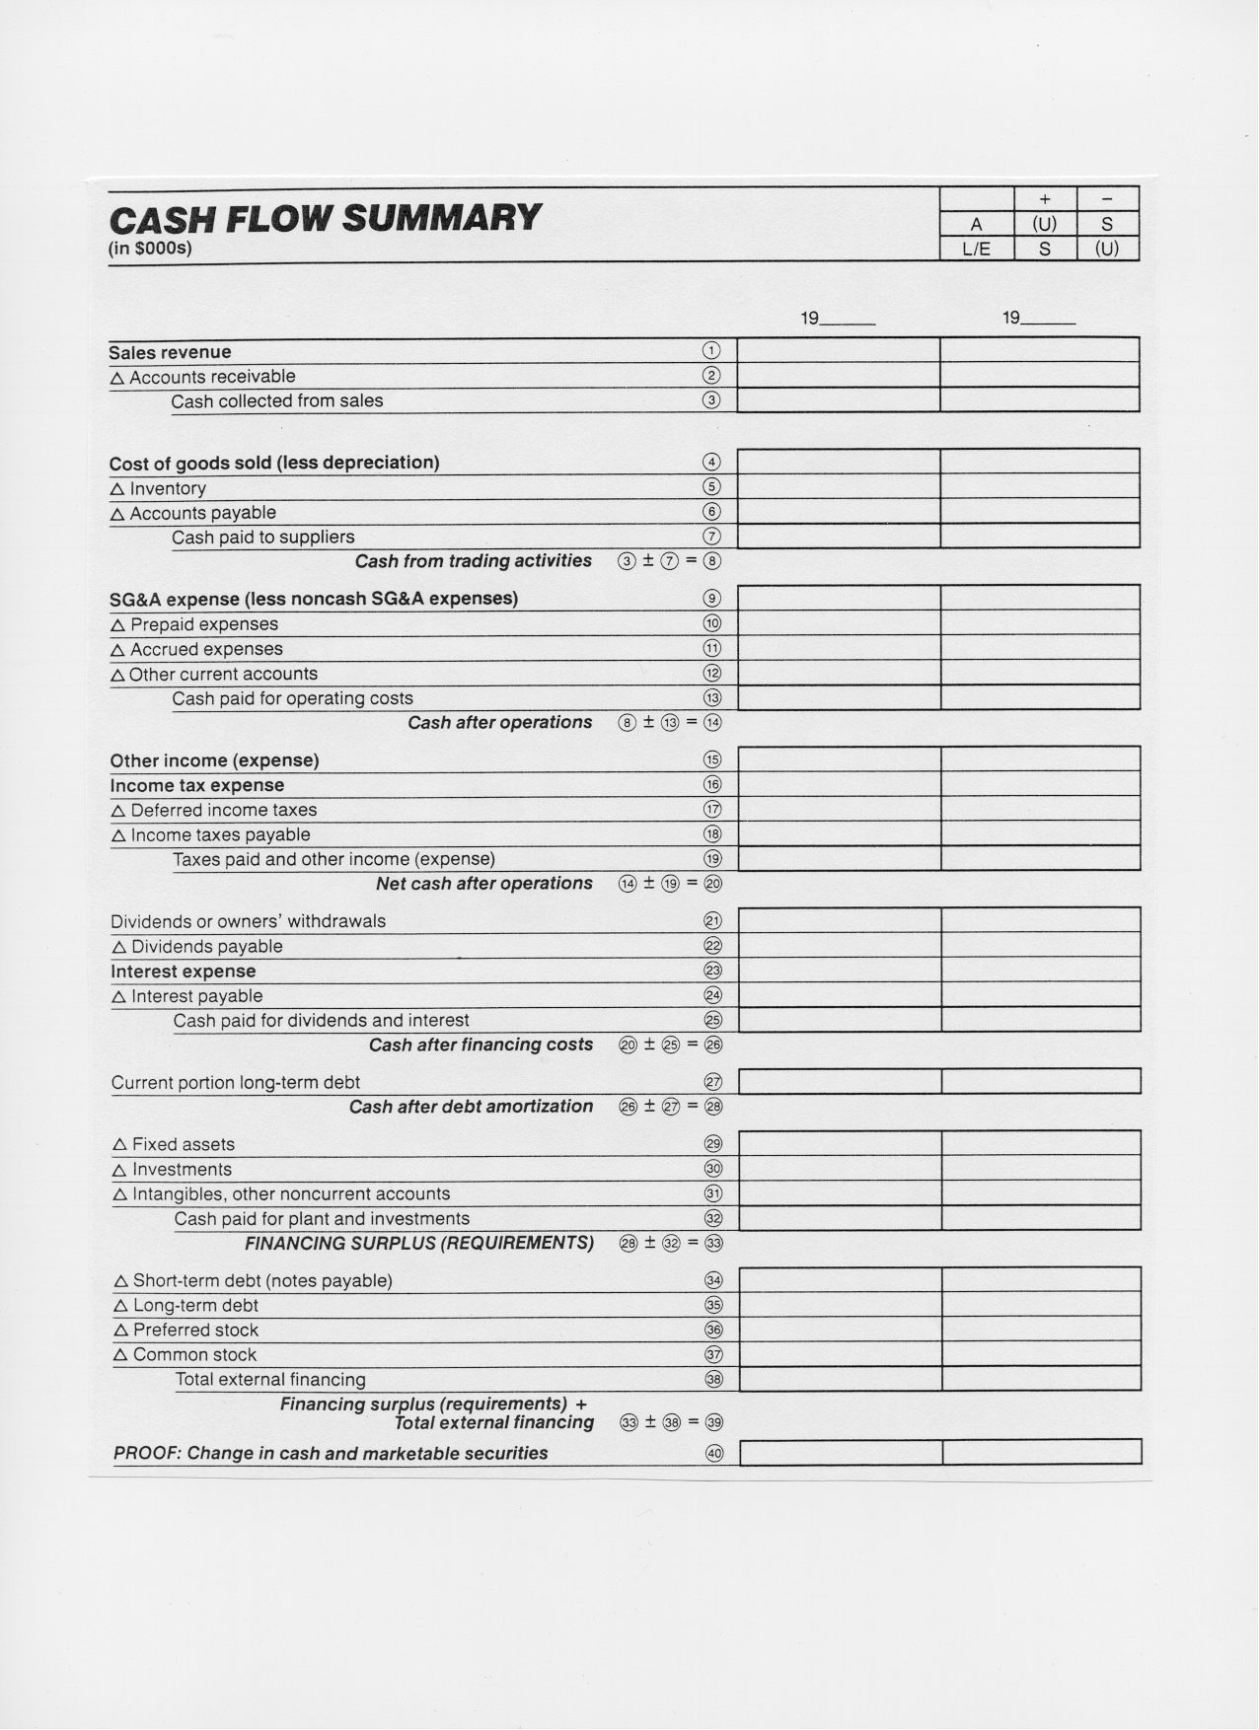
Notes:
After you understand the basic message you need to communicate, you must identify and define the audience or audiences who should receive the message.
When you’re communicating to employees, you have a vast array of audiences to choose from.
Often times, when leaders or managers communicate something internally, they fail to recognize the subtle, and sometimes not so subtle, differences between different groups of employees.
Overlooking this fact can doom your communications effort before you ever begin to put the proverbial pen to paper.

Slide 6
Thank you
Thank You!
Charles B. (Chip) Ruscher, PhD
Department of Finance and Business Economics

